Slide 1


James in the Suburbs
A Disorderly Parable of the Epistle of James

Slide 2
Review

Slide 3
  So far in the Epistle of James:
  James taught us how to deal with our ________ by teaching us how to ask for ________without _________.
Notes:
If you think that it is going to be boring from here on out . . . Think again . . . We might disagree with James or each other. This is very controversial stuff!

Slide 4
  So far in the Epistle of James:
  James taught us how to deal with our problems by teaching us how to ask for wisdom without doubting.
Notes:
If you think that it is going to be boring from here on out . . . Think again . . . We might disagree with James or each other. This is very controversial stuff!

Slide 5
  So far in the Epistle of James:
  James taught us how to deal with our problems by teaching us how to ask for wisdom without doubting.
  James tells us that our lives should be ones of ____ and _________ Worship
Notes:
If you think that it is going to be boring from here on out . . . Think again . . . We might disagree with James or each other. This is very controversial stuff!

Slide 6
  So far in the Epistle of James:
  James taught us how to deal with our problems by teaching us how to ask for wisdom without doubting.
  James tells us that our lives should be ones of Pure and Undefiled Worship
Notes:
If you think that it is going to be boring from here on out . . . Think again . . . We might disagree with James or each other. This is very controversial stuff!

Slide 7
  So far in the Epistle of James:
  James taught us how to deal with our problems by teaching us how to ask for wisdom without doubting.
  James tells us that our lives should be ones of Pure and Undefiled Worship
  Everything from here on out in the book of James is an ________ of Pure and Undefiled Worship
Notes:
If you think that it is going to be boring from here on out . . . Think again . . . We might disagree with James or each other. This is very controversial stuff!

Slide 8
  So far in the Epistle of James:
  James taught us how to deal with our problems by teaching us how to ask for wisdom without doubting.
  James tells us that our lives should be ones of Pure and Undefiled Worship
  Everything from here on out in the book of James is an example of Pure and Undefiled Worship
Notes:
If you think that it is going to be boring from here on out . . . Think again . . . We might disagree with James or each other. This is very controversial stuff!

Slide 9
The 10 Examples
Impartiality
Produces Good works
Speaks Words that Bless
Sows Seeds of Peace
Does Not Judge Others
Knows God is in Control
Gives Resources to Others
Endures until Christ Returns
Speaks Truth
Prays

Slide 10
Week 9: A Life of Worship Does Not Judge Others

Slide 11
¹¹ Do not speak evil against one another, brothers and sisters. Whoever speaks evil against another or judges another, speaks evil against the law and judges the law; but if you judge the law, you are not a doer of the law but a judge. ¹² There is one lawgiver and judge who is able to save and to destroy. So who, then, are you to judge your neighbor? (Jam 4:11-12 NRS)

Slide 12
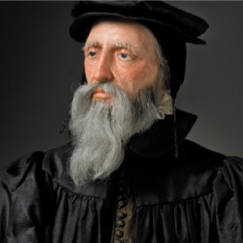
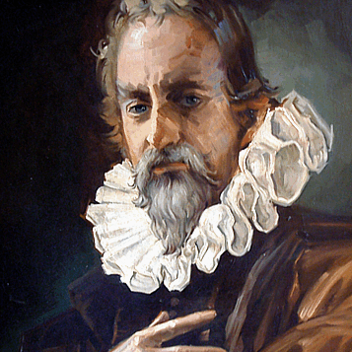
John Calvin and Michael Servetus
Notes:
Calvin: a French lawyer who was Catholic with an interest in theology – leader in the protestant reformation
Servetus: an accomplished Spanish physician with an interest in theology – also a leader in the protestant reformation
Problem: Servetus developed a non-Trinitarian theology saying that “the Trinity” was not scriptural. He believed Jesus was divine, but a manifestation of the one true God – not a separate personality. He also disagreed with Calvin’s theology of predestination.
What happened:
Calvin sent Servetus his “Institutes of Christian Religion” Servetus read it and corrected it. Calvin was furious.
They exchanged a series of letters – Servetus wanted a debate. Calvin wanted to shut him down. When Servetus clung to his beliefs, Calvin cut off correspondence, but not after telling Servetus to stay away from Geneva (where Calvin lived) or Calvin would have him arrested and killed.
Servetus went to Geneva – Calvin had him arrested
He was convicted of two things: 1) Anti-Trinitarian and 2) Against Infant Baptism
Burned at the stake.

Slide 13
Judgment vs Compassion
Judgment
Compassion
Calvin: “Whoever shall maintain that wrong is done to heretics and blasphemers in punishing them makes himself an accomplice in their crime and guilty as they are . . . so that we spare not kin, nor blood of any, and forget all humanity when the matter is to combat for His glory.”
Jesus: "'You shall love the Lord your God with all your heart, and with all your soul, and with all your mind.‘ This is the greatest and first commandment. And a second is like it: 'You shall love your neighbor as yourself.‘ ⁴⁰ On these two commandments hang all the law and the prophets.“ Mat 22:36-40 NRS
Notes:
People will excuse Christians behavior saying “it was just the way things were back then”. . . But Jesus preached love 2000 years ago. There really is no excuse.

Slide 14
Questions . . .
When “Love your neighbor” is the 2nd most important command, who was the heretic? The one with wrong theology or the one without love?
Do the followers of Christ have to agree theologically to do God’s work together? Servetus loved Jesus and the scriptures. He just didn’t think God was three distinct persons.
What about his death showed the love of Jesus to the world?

Slide 15

When we judge, we run the
risk of blasphemy:
Jesus: ²⁸ "Truly I tell you, people will be forgiven for their sins and whatever blasphemies they utter; ²⁹ but whoever blasphemes against the Holy Spirit can never have forgiveness, but is guilty of an eternal sin.” (Mar 3:28-30 NRS)
Notes:
Jesus had been healing and gaining so much notoriety that he couldn’t even get to a quiet place where he could have a meal. A rumor had started that he was “out of his mind” and that he had “an unclean spirit.”
Jesus heard this rumor and spoke these words (Read).
People were judging Jesus’s works – the works of the Holy Spirit – to be evil. Jesus tells them that judging an act that is of the Spirit to be evil is unforgiveable. Today the Holy Spirit works through you and me. It is a stern warning for me to judge the work you in the name of God as evil. It is a stern warning that when we judge the works of the Holy Spirit to be evil, we cross a line.

Slide 16
  A Life of Pure and Undefiled Worship
  does not judge others.
  But how do we balance that with speaking the truth in love?

Slide 17
¹¹ Do not speak evil against one another, brothers and sisters. Whoever speaks evil against another or judges another, speaks evil against the law and judges the law; but if you judge the law, you are not a doer of the law but a judge. ¹² There is one lawgiver and judge who is able to save and to destroy. So who, then, are you to judge your neighbor? (Jam 4:11-12 NRS)
Notes:
The word evil is not there in the Greek. The translators have added it, because apparently they didn’t think it was wrong to simply “speak against one another.” But that is not what James said. He said it was wrong to “speak against” period. It didn’t have to be “evil’.
For example, spreading true gossip about someone is just as bad as spreading false gossip about someone.

Slide 18

Rodney’s Dilemma
Notes:
Background: Rodney is a medical missionary home on leave from Malawi. His job while he is on furlough is to raise money for his work. He has a heart for the poor and really struggles with judging American Christians as selfish. So at the Bible study that month . . . Read Pages 145-147.

Slide 19
The Group’s Advice to Rodney
Ask for Wisdom: Since every situation will be different, ask God for wisdom in every situation and do not speak up until you feel God is leading you to speak.
Act out of Love: Never speak up when you aren’t doing it out of love for the person you are confronting.
Appropriate Time and Place: Speaking up in a public place and in front of others isn’t usually a good idea. Honor the person you are speaking to with respect and privacy.
Notes:
Walk through these then tell the story of Beebe:
Beebe’s daughter and son-in-law were having financial problems. And yet, they were spending a fortune decorating their baby’s bedroom. Beebe became obsessed with the fact that they were wasting money on the baby room that they should be using to pay off their debts. Is Beebe being judgmental or should she talk to them about this?
Ask for Wisdom – Only way to know if you should talk or not. This isn’t likely to be a shoot up the prayer and give God two seconds to answer. Beebe needs to set aside quiet time to lay the situation out before God and ask God what to do. “God, I think I have wisdom in this area that I should share with my daughter. It could be good – because maybe she doesn’t realize that no one will see that room except her family and the baby is too young to enjoy it yet. Maybe she thinks she has to do this to be a good mother. It could be bad – because she and her husband might consider me meddling and I would be putting more stress on them to make decisions that I like. Lay it out and then wait for God to speak.
Act out of Love – As Beebe prayed, she meditated on why this was bothering her so much. Was it because she didn’t really like the way they were decorating? Was it because they hadn’t taken her shopping with them? Or was she acting out of love for her daughter?
After several days of prayer, in Beebe’s case, while praying, she realized that she felt so strongly about the room, because she hadn’t had money to decorate her daughter’s room and had made the choice not to. And she was taking her daughter’s decision and feeling hurt by it – like she had made the wrong decision herself. It was then she realized that God was opening the door to having the conversation by allowing her to tell her daughter about those days and how hard it was not to have money to decorate her room. To ask her daughter if she felt she made the wrong decision. She would talk in a way that would praise the daughter for showing so much love to the baby, but that also gave her permission to be a good mom without spending a lot of money on the baby too – to know it would be okay without a lot of money. Beebe realized this not so much about speaking the truth, but about supporting her daughter who would make different decisions than herself.
Location: The location was very natural – just the two of them – over tea one afternoon.
Do you see how this could have been divisive had Beebe not asked for wisdom, examined her motives, and planned the best time to communicate?

Slide 20
Self-Assessment
Who do you judge (criticize) the most?
Should you address what is bothering you?
  Have you asked God for wisdom?
  Would you be speaking out of love to them? If not:
    Is this your problem and not theirs?
    Can you ask God to give you love for them?
  Can you approach them in an appropriate time and place?
Notes:
Skip if it is 7:00 already. Otherwise give me a few min.
Having just gone through Thanksgiving and spent it with family, you may have encountered someone who you are having judgmental thoughts about. Or maybe it is someone here at church or work. Think about them for a second.

Slide 21
The 10 Examples
Impartiality
Produces Good works
Speaks Words that Bless
Sows Seeds of Peace
Does Not Judge Others
Knows God is in Control
Gives Resources to Others
Endures until Christ Returns
Speaks Truth
Prays

Slide 22
Week 9: A Life of Worship Knows God is in Control

Slide 23
James says:
¹³ Come now, you who say, "Today or tomorrow we will go to such and such a town and spend a year there, doing business and making money.“ ¹⁴ Yet you do not even know what tomorrow will bring. What is your life? For you are a mist that appears for a little while and then vanishes. ¹⁵ Instead you ought to say, "If the Lord wishes, we will live and do this or that.“ ¹⁶ As it is, you boast in your arrogance; all such boasting is evil. ¹⁷ Anyone, then, who knows the right thing to do and fails to do it, commits sin. (Jam 4:13-17 NRS)

Slide 24
How does knowing God is in control cause us to plan differently?
Notes:
Different priorities
We see the big cosmic picture – not the little one. We see eternity not just today.
We share resources because we know God will provide
We make choices to do God’s will and leave the details to God.
We have different goals: Not to get rich, be popular, powerful or successful.
We pray before we plan

Slide 25
How does knowing God is in control cause us to plan differently at work?
Notes:
Different priorities
Honesty, Integrity become very important

Slide 26
Three planning edicts from the Lord’s Prayer
Thy Kingdom Come ← Prioritize the Kingdom in our planning (Big GOD-sized Thinking!)
Thy will be done ← Commit to knowing and doing God’s will
Give us our Daily Bread ← Sometimes daily instructions are all we get – Often we don’t get the whole picture

Slide 27
Jesus says:
¹⁶ Then he told them a parable: "The land of a rich man produced abundantly. ¹⁷ And he thought to himself, 'What should I do, for I have no place to store my crops?‘ ¹⁸ Then he said, 'I will do this: I will pull down my barns and build larger ones, and there I will store all my grain and my goods. ¹⁹ And I will say to my soul, 'Soul, you have ample goods laid up for many years; relax, eat, drink, be merry.‘ ²⁰ But God said to him, 'You fool! This very night your life is being demanded of you. And the things you have prepared, whose will they be?‘ ²¹ So it is with those who store up treasures for themselves but are not rich toward God." (Luk 12:16-21 NRS)

Slide 28
Jesus says (to our culture):
The worker performed great in his or her job and got lots of raises. The worker thought to themselves: “What should I do with all of this money? I need a good investment.” So they bought Microsoft at $20. After the stock split several times, the worker said, “I can retire in the lap of luxury!” But God said to the worker, “You fool! Tonight you are going to die. What is your stock worth to you now?” So it is with those who store up treasures for themselves, but who are not rich toward God.

Slide 29
What treasures are you storing that you can’t take with you?

Slide 30
How can you be rich toward God?
Notes:
Share your blessings!

Slide 31
What does a person who is rich toward God do with their treasures?

Slide 32
When we make plans believing that we can make them happen, we sin.
Only God can bring our plans into being.
Notes:
This sin takes us all the way back to the Garden of Eden. Adam and Eve – when they ate of the fruit – were saying to God, “We are making plans without you – to become independent of you.” This is not a passive sin – it is aggressively evil.

Slide 33
Those who worship God recognize that God is in control of everything and they willingly (joyfully even) yield to God’s control.
Notes:
This sin takes us all the way back to the Garden of Eden. Adam and Eve – when they ate of the fruit – were saying to God, “We are making plans without you – to become independent of you.” This is not a passive sin – it is aggressively evil.

Slide 34
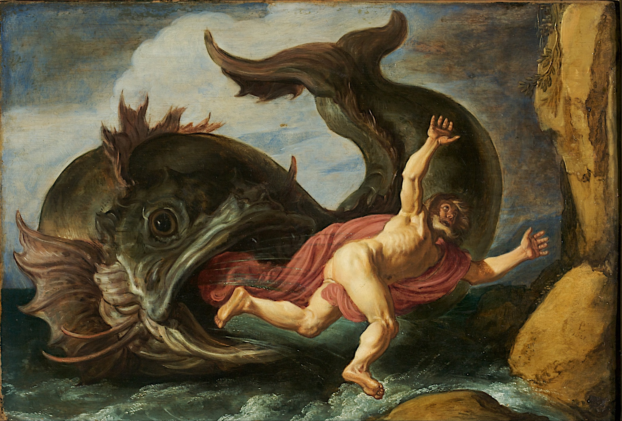
Notes:
Jonah had plans that God didn’t have. He thought being a prophet would be pretty cool – he liked speaking in public and thought it would make him popular and powerful. Then God sends him to Ninevah to tell them their time is up. This is not going to make Jonah popular, powerful, or successful. They are going to yell at him, ignore him, or worse. So he says “forget God’s plans” and catches the first boat out of town. A storm kicks up, the sailors throw him over, and a fish swallows him. Now he has time to think. Will he choose God’s plans or his own. He decides to go with God’s plans.
The fish spits him out and God sends him back to Ninevah. He has decided that it won’t be so bad – he will tell them they are all going to die because of their sins and then get far enough away to watch God blow them all up. But they actually listen to Jonah which you would think would make Jonah happy. They repent and ask God to forgive them. BUT Jonah is really mad. He is going to look like an idiot for preaching doom and gloom when God is going to save them. So he is mad at God.
Jonah is a guy who had made his own plans without considering God might have different plans. Now he has a choice – he can be miserable because God had different plans or he can be joyful that God had different plans. It is his choice.

