Slide 1


James in the Suburbs
A Disorderly Parable of the Epistle of James

Slide 2
Review: Week 6
Pure and Undefiled Worship
Notes:
Last week we talked about pure and undefiled worship. What is the first example that God gives us of pure and undefiled worship?
Who were we to take care of? Vulnerable people
How were we to live our own lives? Unstained by the world
How are we stained by the world?
When we follow the way of the world and not the way of Christ.
A Christian is always fighting this !

Slide 3
The life of a servant of Christ is a life of pure and undefiled worship.

Slide 4
Religion vs Christianity
Religion has a formula to follow that tries to commandeer God’s blessings
Christianity has Jesus to follow. We already have God’s blessings through Jesus.
Notes:
We also discussed the difference between religion and worship. What is the difference between religion and worship?

Slide 5
  Christianity is not a religion that tries to control God’s blessings
  Christianity is a relationship that worships God.
Notes:
Everything from here on out in the books of James is an example of

Slide 6
  Everything from here on out in the book of James
  Is an example of?
  Pure and Undefiled Worship
Notes:
If you think that it is going to be boring from here on out . . . Think again . . . We might disagree with James or each other. This is very controversial stuff!

Slide 7
Week 7
A Life of Worship is Impartial

Slide 8
My brothers and sisters, do you with your acts of favoritism really believe in our glorious Lord Jesus Christ? ² For if a person with gold rings and in fine clothes comes into your assembly, and if a poor person in dirty clothes also comes in, ³ and if you take notice of the one wearing the fine clothes and say, "Have a seat here, please," while to the one who is poor you say, "Stand there," or, "Sit at my feet,“ ⁴ have you not made distinctions among yourselves, and become judges with evil thoughts? ⁵ Listen, my beloved brothers and sisters. Has not God chosen the poor in the world to be rich in faith and to be heirs of the kingdom that he has promised to those who love him? ⁶ But you have dishonored the poor. Is it not the rich who oppress you? Is it not they who drag you into court? ⁷ Is it not they who blaspheme the excellent name that was invoked over you? ⁸ You do well if you really fulfill the royal law according to the scripture, "You shall love your neighbor as yourself.“ ⁹ But if you show partiality, you commit sin and are convicted by the law as transgressors. ¹⁰ For whoever keeps the whole law but fails in one point has become accountable for all of it. ¹¹ For the one who said, "You shall not commit adultery," also said, "You shall not murder." Now if you do not commit adultery but if you murder, you have become a transgressor of the law. ¹² So speak and so act as those who are to be judged by the law of liberty. ¹³ For judgment will be without mercy to anyone who has shown no mercy; mercy triumphs over judgment. (Jam 2:1-13 NRS)

Slide 9
My brothers and sisters, do you with your acts of favoritism really believe in our glorious Lord Jesus Christ?
Notes:
What is favoritism?

Slide 10
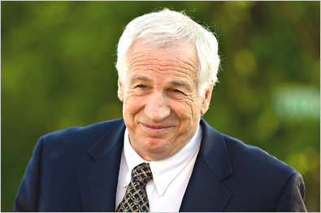
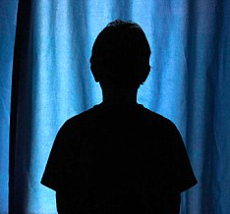
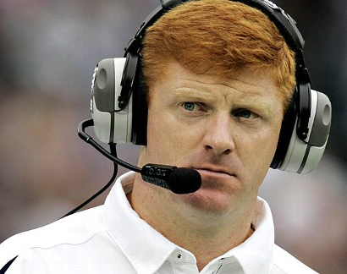
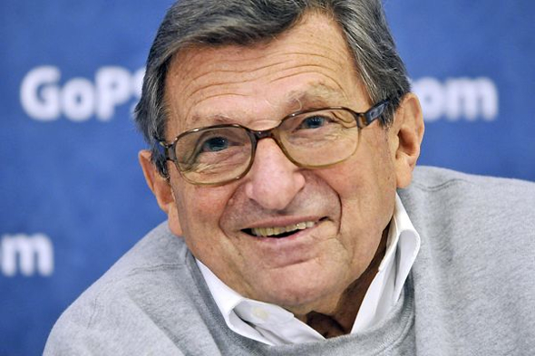

Notes:
Mike McQueary
Jerry Sandusky
Ten-Year Old Child
Joe Paterno

Slide 11
Favoritism is when we choose the best interests of the powerful over the powerless.
Mike McQueary and Joe Paterno practiced favoritism.
Notes:
How did Mike McQueary practice favoritism?
He chose Sandusky over the child
He chose his career over the child
He followed a chain of command over the child
How did Joe Paterno practice favoritism?
He chose Sandusky over the child

Slide 12
Have you ever practiced favoritism?

Slide 13
Have you ever put the best interest of
The powerful over the powerless?
The VIPs over the marginalized?
Your family over strangers?
Your neighbors over your enemies?
Notes:
How do you or others experience favoritism (or discrimination) in the world today?

Slide 14
“Everyone does it! It is a fact of life especially in business.”
“Who hasn’t experienced discrimination? Get over it!”
  “It is NOT a Big Deal!?!?”
Did James think it was a big deal?

Slide 15
My brothers and sisters, do you with your acts of favoritism really believe in our glorious Lord Jesus Christ?
And later . . .
⁹ But if you show partiality, you commit sin and are convicted by the law as transgressors. ¹⁰ For whoever keeps the whole law but fails in one point has become accountable for all of it. ¹¹ For the one who said, "You shall not commit adultery," also said, "You shall not murder." Now if you do not commit adultery but if you murder, you have become a transgressor of the law.
Notes:
James questions the sincerity of the faith of those who practice favoritism.
Further more James example of not giving the best seat to the poor man is hardly noteworthy compared to my example. How much harm do we do when we make the poor stand in the back compared to what McQueary did? Yet, James says even that make your faith questionable!
Later he compares those who discriminate to murders and adulterers. Not Good!
In other words it is a HUGE deal.

Slide 16
² For if a person with gold rings and in fine clothes comes into your assembly, and if a poor person in dirty clothes also comes in . . .
Dirty = rhypros = moral filth
² For if a person with gold rings and in fine clothes comes into your assembly, and if a poor person in moral filth also comes in . . .
Notes:
There were some Jewish sects that considered poverty a blessing. Most did not.
Poverty was a disgrace – a sign that you’ve lost favor with God
The poor couldn’t keep the law – cleanliness costs money, purifying sacrifices cost money, they were immoral in the eyes of Jews.
For us . . . Sometimes we think it is okay to discriminate if we deem the person morally reprehensible. For instance, if we think they are poor because they have an alcohol problem or are lazy. James did not think so.
Why? Because Christ’s blood covered all sin. It left no second class citizens. We don’t really believe in Jesus if we don’t believe this – that his blood covers all moral filth and all curses.

Slide 17
James teaches us that even a morally filthy person should not be pushed to the margins of the Christian community. They should be invited in, given a seat at our table, and valued.
We should see ourselves as servants of this person.
Notes:
There were some Jewish sects that considered poverty a blessing. Most did not.
Poverty was a disgrace – a sign that you’ve lost favor with God
The poor couldn’t keep the law – cleanliness costs money, purifying sacrifices cost money, they were immoral in the eyes of Jews.
For us . . . Sometimes we think it is okay to discriminate if we deem the person morally reprehensible. For instance, if we think they are poor because they have an alcohol problem or are lazy. James did not think so.

Slide 18
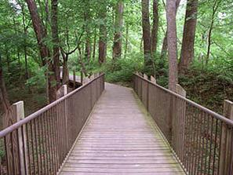
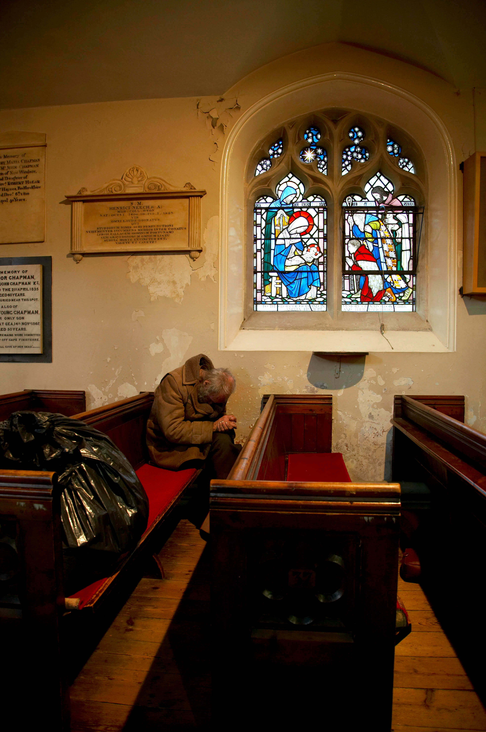
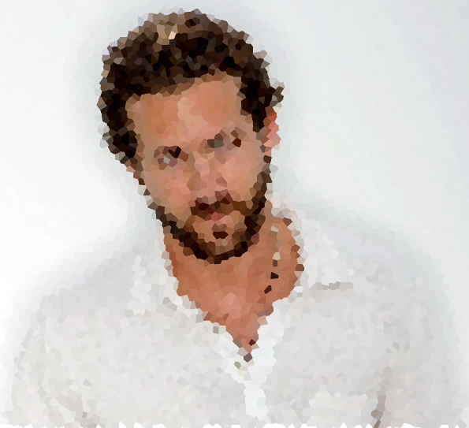
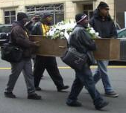
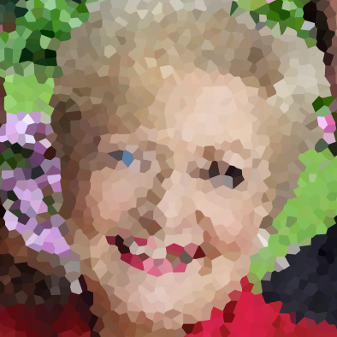
Notes:
Tell the story of the homeless at the Church in the Suburbs
Homeless living on the greenway
One of their own dies - The church in the suburbs does the funeral
They start coming to church – yikes!
People didn’t like sitting in the pews next to them
Bright idea: Give them their own church! Hired a pastor for them. In the afternoon, when they won’t bother us.
Why could giving them their own church be a bad idea? 1) Can’t get to know them and their needs. 2) Jesus had first hand relationships with those in need – he did not have a broker (like some charitable organizations become.
Liz disagree with the idea of having separate churches, but volunteered there for years
Now with economically hard times – TCintheS want to shut it down and hire security to keep them away.
Rodney joins Liz in fighting against. They loose.
Favoritism! We are putting our best interest before the poor.

Slide 19
⁴ Have you not made distinctions among yourselves, and become judges with evil thoughts?
Notes:
James not only doubts our faith when we discriminate, but he says we are judges with evil thoughts!
Who is the only judge? Jesus
Why is that good news for us? We are set free to love! Not fix! But love!!!

Slide 20
What are ways that churches practice segregation?
Notes:
Economical
Race
Theological beliefs
Women being leaders
Worship style

Slide 21
Paul agreed with James:
²⁸ There is no longer Jew or Greek, there is no longer slave or free, there is no longer male and female; for all of you are one in Christ Jesus. (Gal 3:28 NRS)
Notes:
Tell story of Bibletown . . . Summer camp. Reading this verse over and over every day. They had this verse over their conference center stage. It was there because of the missionary conferences they held. They felt this was true for every race – it was their way of welcoming diverse cultures. But it was not true for women. Women were not allowed to have leadership roles.

Slide 22
What is the cure for discrimination?
The Law of Liberty = Mercy not Judgement

Slide 23
Cure for Discrimination
Old Testament Law
Law of Liberty
Humanity carried the burden of trying to please God.
A long list of rules that we judged each other by.
We always failed – always another sacrifice for our sins.
Hopeless, laborious, defeating
Through Christ’s death and resurrection, Christ showed mercy not judgment
Therefore we are set free from judging and set free to love.
We too can offer mercy not judgement

Slide 24
The Twist
Notes:
Jerry Sandusky shows up at church this Sunday . . . What kind of seat would we give him? Would we treat him with mercy and not judgment? How would we balance that will the practical aspects of protecting our children?
It is complicated.

Slide 25
Week 8
A Life of Worship Produces Good Works

Slide 26
What good is it, my brothers and sisters, if you say you have faith but do not have works? Can faith save you? ¹⁵ If a brother or sister is naked and lacks daily food, ¹⁶ and one of you says to them, "Go in peace; keep warm and eat your fill," and yet you do not supply their bodily needs, what is the good of that? ¹⁷ So faith by itself, if it has no works, is dead. ¹⁸ But someone will say, "You have faith and I have works." Show me your faith apart from your works, and I by my works will show you my faith. ¹⁹ You believe that God is one; you do well. Even the demons believe-- and shudder. ²⁰ Do you want to be shown, you senseless person, that faith apart from works is barren? ²¹ Was not our ancestor Abraham justified by works when he offered his son Isaac on the altar? ²² You see that faith was active along with his works, and faith was brought to completion by the works. ²³ Thus the scripture was fulfilled that says, "Abraham believed God, and it was reckoned to him as righteousness," and he was called the friend of God. ²⁴ You see that a person is justified by works and not by faith alone. ²⁵ Likewise, was not Rahab the prostitute also justified by works when she welcomed the messengers and sent them out by another road? ²⁶ For just as the body without the spirit is dead, so faith without works is also dead. (Jam 2:14-26 NRS)

Slide 27
Can faith save you?

Slide 28
Paul thought so . . .
⁸ For by grace you have been saved through faith, and this is not your own doing; it is the gift of God-- not the result of works, so that no one may boast. (Eph 2:8-9 NRS)

Slide 29
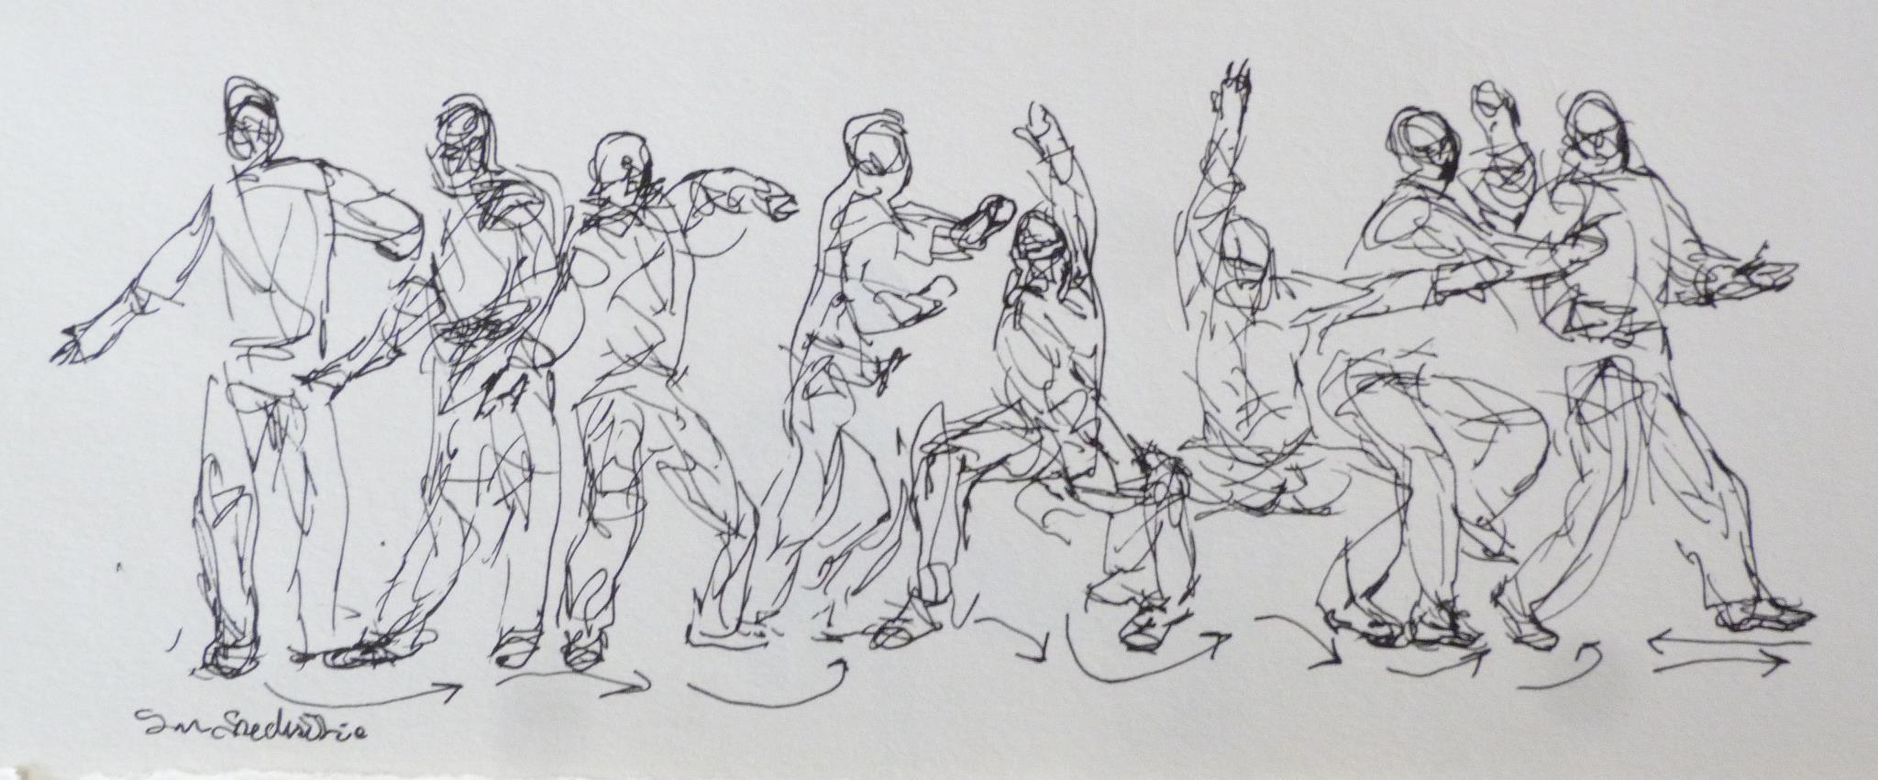
Pastor Eddie Dances
t
Notes:
Read outloud pages 121-124.

Slide 30
Eddie’s preacher was not inviting Eddie to become a servant of God who would produce good works directed by the Holy Spirit. He was inviting him to pray a magic prayer to get a ticket to heaven.

Slide 31
Faith and Works always go Hand in Hand.
You can’t have one without the other.

Slide 32
What is faith?

Slide 33
What good is it, my brothers and sisters, if you say you have faith but do not have works? Can faith save you? ¹⁵ If a brother or sister is naked and lacks daily food, ¹⁶ and one of you says to them, "Go in peace; keep warm and eat your fill," and yet you do not supply their bodily needs, what is the good of that? ¹⁷ So faith by itself, if it has no works, is dead. ¹⁸ But someone will say, "You have faith and I have works." Show me your faith apart from your works, and I by my works will show you my faith. ¹⁹ You believe that God is one; you do well. Even the demons believe-- and shudder. ²⁰ Do you want to be shown, you senseless person, that faith apart from works is barren? ²¹ Was not our ancestor Abraham justified by works when he offered his son Isaac on the altar? ²² You see that faith was active along with his works, and faith was brought to completion by the works. ²³ Thus the scripture was fulfilled that says, "Abraham believed God, and it was reckoned to him as righteousness," and he was called the friend of God. ²⁴ You see that a person is justified by works and not by faith alone. ²⁵ Likewise, was not Rahab the prostitute also justified by works when she welcomed the messengers and sent them out by another road? ²⁶ For just as the body without the spirit is dead, so faith without works is also dead. (Jam 2:14-26 NRS)

Slide 34
What is faith?
Faith cares for those in need
Notes:
It isn’t just verbalized

Slide 35
What good is it, my brothers and sisters, if you say you have faith but do not have works? Can faith save you? ¹⁵ If a brother or sister is naked and lacks daily food, ¹⁶ and one of you says to them, "Go in peace; keep warm and eat your fill," and yet you do not supply their bodily needs, what is the good of that? ¹⁷ So faith by itself, if it has no works, is dead. ¹⁸ But someone will say, "You have faith and I have works." Show me your faith apart from your works, and I by my works will show you my faith. ¹⁹ You believe that God is one; you do well. Even the demons believe-- and shudder. ²⁰ Do you want to be shown, you senseless person, that faith apart from works is barren? ²¹ Was not our ancestor Abraham justified by works when he offered his son Isaac on the altar? ²² You see that faith was active along with his works, and faith was brought to completion by the works. ²³ Thus the scripture was fulfilled that says, "Abraham believed God, and it was reckoned to him as righteousness," and he was called the friend of God. ²⁴ You see that a person is justified by works and not by faith alone. ²⁵ Likewise, was not Rahab the prostitute also justified by works when she welcomed the messengers and sent them out by another road? ²⁶ For just as the body without the spirit is dead, so faith without works is also dead. (Jam 2:14-26 NRS)

Slide 36
What is faith?
Faith cares for those in need
Faith is not about having a correct theology
Notes:
About the only thing that the early church agreed upon was that Jesus had risen from the dead.

Slide 37
What good is it, my brothers and sisters, if you say you have faith but do not have works? Can faith save you? ¹⁵ If a brother or sister is naked and lacks daily food, ¹⁶ and one of you says to them, "Go in peace; keep warm and eat your fill," and yet you do not supply their bodily needs, what is the good of that? ¹⁷ So faith by itself, if it has ²⁰ Do you want to be shown, you senseless person, that faith apartno works, is dead. ¹⁸ But someone will say, "You have faith and I have works." Show me your faith apart from your works, and I by my works will show you my faith. ¹⁹ You believe that God is one; you do well. Even the demons believe-- and shudder. from works is barren? ²¹ Was not our ancestor Abraham justified by works when he offered his son Isaac on the altar? ²² You see that faith was active along with his works, and faith was brought to completion by the works. ²³ Thus the scripture was fulfilled that says, "Abraham believed God, and it was reckoned to him as righteousness," and he was called the friend of God. ²⁴ You see that a person is justified by works and not by faith alone. ²⁵ Likewise, was not Rahab the prostitute also justified by works when she welcomed the messengers and sent them out by another road? ²⁶ For just as the body without the spirit is dead, so faith without works is also dead. (Jam 2:14-26 NRS)

Slide 38
What is faith?
Faith cares for those in need
Faith is not about having a correct theology
Faith is obedience to God
Notes:
Abraham and Sarah collaborate on how to help God produce a heir. ←Failed in Obedience
Years Later . . .
God told Abraham to sacrifice Isaac. This time he puts his trust in God – also in the impossible. ←Succeeded with Faith this time!

Slide 39
What good is it, my brothers and sisters, if you say you have faith but do not have works? Can faith save you? ¹⁵ If a brother or sister is naked and lacks daily food, ¹⁶ and one of you says to them, "Go in peace; keep warm and eat your fill," and yet you do not supply their bodily needs, what is the good of that? ¹⁷ So faith by itself, if it has ²⁰ Do you want to be shown, you senseless person, that faith apartno works, is dead. ¹⁸ But someone will say, "You have faith and I have works." Show me your faith apart from your works, and I by my works will show you my faith. ¹⁹ You believe that God is one; you do well. Even the demons believe-- and shudder. from works is barren? ²¹ Was not our ancestor Abraham justified by works when he offered his son Isaac on the altar? ²² You see that faith was active along with his works, and faith was brought to completion by the works. ²³ Thus the scripture was fulfilled that says, "Abraham believed God, and it was reckoned to him as righteousness," and he was called the friend of God. ²⁴ You see that a person is justified by works and not by faith alone. ²⁵ Likewise, was not Rahab the prostitute also justified by works when she welcomed the messengers and sent them out by another road? ²⁶ For just as the body without the spirit is dead, so faith without works is also dead. (Jam 2:14-26 NRS)

Slide 40
What is faith?
Faith cares for those in need
Faith is not about having a correct theology
Faith is obedience to God
Faith risks everything to serve God
Notes:
Rahab the prostitute:

Slide 41
A life of Worship has faith that produces good works.

Slide 42
Looking for an opportunity to serve?
Thanksgiving Lunch at Saint David’s – Contact Judy Beachum

