Slide 1


James in the Suburbs
A Disorderly Parable of the Epistle of James

Slide 2
Review
Week 1: Introduction to the Study: Parable/commentary
Week 2: Introduction to the Epistle of James: Mystery and Controversy
Week 3: James’s Strategy for handling our problems so we can move on towards serving God
Notes:
Parable/commentary – This is how Jesus taught!
Mystery and Controversy –
What was the Mystery? (who wrote it) and
What was the Controversy? (many of the “great theologians said it was straw” – yet it mimics the words of Jesus in the sermon on the mount
James Strategy --- More info next page . . .

Slide 3
James’s Strategy for Handling Problems
Accept Problems as a Servant’s Way of Life
Understand the Problem
See the Problem as Joy
Endure the Problem (but not idly)
Ask for Wisdom (without doubting that God will give wisdom – ask and wait patiently until God speaks)
Notes:
Everything James has taught in the Epistle so far has been with the purpose of helping his congregants handle their problems so that they could become effective servants of Christ.

Slide 4
Review
Week 1: Introduction to the Study
Week 2: Introduction to the Epistle of James
Week 3: James’s Strategy
Week 4: Wisdom and Doubting
Notes:
What are we turning from? (Focus on ourselves – our problems)
What are we turning to? (Focus on servanthood!)
Two Problems: Having too much and having too little – Having too much (how do you share your blessings) and Having too little (how do you rely on God). But no matter where you are . . . You have too much or too little . . . You are still to serve God where you are at.

Slide 5
How do we get wisdom?
We Ask!
Notes:
Who does God Give wisdom to? Do you have to be good enough?
How do you ask for Wisdom? Prayer – but you have to listen! Give example of asking your boss for wisdom (yelling your question into their office as you pass by – but never going into sit down to discuss it)
What are some of the things that keep us from receiving wisdom when we ask?
Not recognizing it – we expect wealth fame and success from God’s wisdom. Sometime we get “sell all you have and follow me”
Sometimes we think we don’t need it – we follow a list of rules and as long as we don’t break a rule – we can do whatever we want
Doubting that God will give it to us (or has given it to us)
***
Why can’t we just follow a set of rules? Why do we have to ask for wisdom?
Can a set of rules tell us how to live in every circumstance?
Do we have a relationship with God through a set of rules?
How do you know what house to buy? Who to marry? Etc.
Do you believe that God wants to be part of every area of your life?

Slide 6
Review
Week 1: Introduction to the Study
Week 2: Introduction to the Epistle of James
Week 3: James’s Strategy
Week 4: Wisdom and Doubting
Week 5: Turning Toward Servanthood – Example of Dealing with Two Problems
Notes:
What does James want us to turn from? (Focus on ourselves – our problems)
What does James want us to turn to? (Focus on servanthood!)
Two Problems: Having too much and having too little – Having too much (how do you share your blessings) and Having too little (how do you rely on God). But no matter where you are . . . Whether you have too much or too little . . . You are still to serve God where you are at.

Slide 7
Week 6
Pure and Undefiled Worship
Notes:
Week 6 – Pure and Undefiled Worship

Slide 8
Understanding
Pure and Undefiled Worship is critical to servanthood.
Notes:
Why? Because if you aren’t going to be focused on your problems any more – what are you going to be focused on? James is very comprehensive in teaching his parish to move from problems to servanthood. And they had real problems – their jobs were being taken away because of their faith, the famine that was hitting Jerusalem area was being blamed on them. Their lives were on the line everyday. Still . . . James did not want them hunkered down hiding. He wanted them serving God.

Slide 9
The rest of the epistle is going to give us example after example of
Pure and Undefiled Worship.
Notes:
These examples are not a complete collection of all the ways to worship God.
But why do you think James thought we needed all of these examples?
Radical new way of living
Our souls have been transformed by Christ, but we are still working with our old minds.
I think James wanted us to know that worshiping God purely and without defilement affects every area of our live. It isn’t just something we can do on Sunday. We do it 24 hours a day!
Note: These examples make practical the sermon on the mount.

Slide 10
If any think they are religious, and do not bridle their tongues but deceive their hearts, their religion is worthless. Religion that is pure and undefiled before God, the Father, is this: to care for orphans and widows in their distress, and to keep oneself unstained by the world.
Jam 1:9-12

Slide 11
Religion: What humanity does to commandeer God’s blessings
The formula for religion is this:
  Figure out what God requires of us (usually the minimum God requires).
  Figure out how to do what God requires it properly
  By doing it properly, we please God, and God is forced to bless us.
Some of the things we humans have done to please God:
  Made Sacrifices (humans, animals, resources, etc)
  Performed Rituals (coin in the fountain, magic spells, sports charms, etc)
  Kept a List of Rules
Notes:
Do you know any Christians who are practicing Christianity as a religion?
The problem is . . . God doesn’t want us to be religious. God wants a relationship with us. Do you know how much God loves us? Tell story of taking Ken’s Spiritual Direction class and coming to the realization that “God wants to spend time with me.” God wants to spend time with you – not to keep you in line, but to fill you with his love and to give you purpose.

Slide 12
Religion: What humanity does to commandeer God’s blessings
Religion has a formula to follow
Christianity has Jesus to follow
Figure out what God requires of us (usually the minimum).
Figure out how to do what God requires properly.
By doing it properly, we please God, and God is forced to bless us.
  God has already done all the work through Jesus – we just say “Yes”
  Jesus did all that was demanded of us. We can’t earn it.
  All of our blessings are gifts.
Notes:
Talk about why Jesus waited to come until the Pharisees were in full bloom – Religion had been perfected.
And it was just years before Christians tried to return to religion instead of relationship with God – Paul and the Galatians. Gotta follow the rules. He had to go in and straighten it out.
Why do we always want to leave the beautiful relationship that God offers us and return to religion!?!?

Slide 13
If any think they are religious, and do not bridle their tongues but deceive their hearts, their religion is worthless. Religion that is pure and undefiled before God, the Father, is this: to care for orphans and widows in their distress, and to keep oneself unstained by the world.
Jam 1:9-12
Notes:
So why does James use the word religion to define our faith?

Slide 14
Religion = θρησκεία = Worship
Notes:
In the rest of scripture, it is almost always translated worship not religion! I guess the translators didn’t have the bias toward the word that I had.
BTW . . . The men (and women – there was one woman on the team) that translated the NIV of the Bible met all winter at the church I grew up in in South Florida and did their work of translating. Many of our church buildings were converted barracks from WW-2. And they met in one of those old buildings. It was dark, but air-conditioned. I attended school there – as well as, going to church there. I can remember being sent into the room where they were working one day to deliver a note to them. And I will never forget watching them work. I could not take my eyes off of them as they gently debated whatever verse they were translating that day.
Anyway . . . I would have debated the use of the word religion with them in this verse. So let’s take the word, religion and stick in worship . . .

Slide 15
If any think they are worshipers, and do not bridle their tongues but deceive their hearts, their worship is worthless. Worship that is pure and undefiled before God, the Father, is this: to care for orphans and widows in their distress, and to keep oneself unstained by the world.
Jam 1:9-12
Notes:
This makes sense to me

Slide 16
The life of a servant of Christ is a life of pure and undefiled worship.

Slide 17

But what does a bridled tongue have to do with worshiping God?

Slide 18
If any think they are worshipers, and do not bridle their tongues but deceive their hearts, their worship is worthless. Worship that is pure and undefiled before God, the Father, is this: to care for orphans and widows in their distress, and to keep oneself unstained by the world.
Jam 1:9-12
Notes:
What does James hinge our life of worship on? Ability to bridle our tongues!
We must stop talking – stop telling God what to do (Bless me! Bless Me! Give me what I want! Take away my problems!)
And we must start listening to what God wants and who God is.
Talking with unbridled tongues = Religion
Listening = Worship = it is the building of a relationship

Slide 19
  Religion operates with an unbridled tongue that defines God.
  Worship operates first in listening mode to the implanted word.
Notes:
Religion is deceptive – it tries to tell God what to do and tries to make God bless us.
But what God wants is a relationship where we listen to God and talk to God, but we don’t define God. We get to know God.

Slide 20
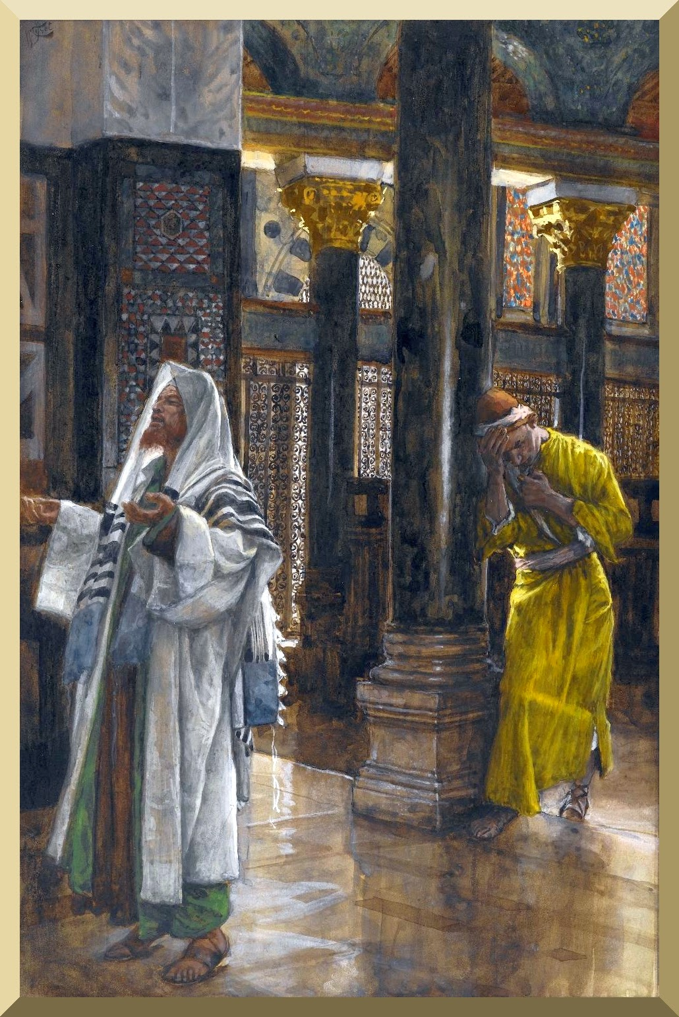
Notes:
Luke 18 → The Pharisee was all about commandeering God’s blessings. He had lots to tell God about how good he was keeping God’s law. The tax collector was the one there worshiping God – repenting – seeking – listening to God.
¹⁰ "Two men went up to the temple to pray, one a Pharisee and the other a tax collector.
¹¹ The Pharisee, standing by himself, was praying thus, 'God, I thank you that I am not like other people: thieves, rogues, adulterers, or even like this tax collector.
¹² I fast twice a week; I give a tenth of all my income.'
¹³ But the tax collector, standing far off, would not even look up to heaven, but was beating his breast and saying, 'God, be merciful to me, a sinner!'
¹⁴ I tell you, this man went down to his home justified rather than the other; for all who exalt themselves will be humbled, but all who humble themselves will be exalted."
(Luk 18:10-14 NRS)

Slide 21
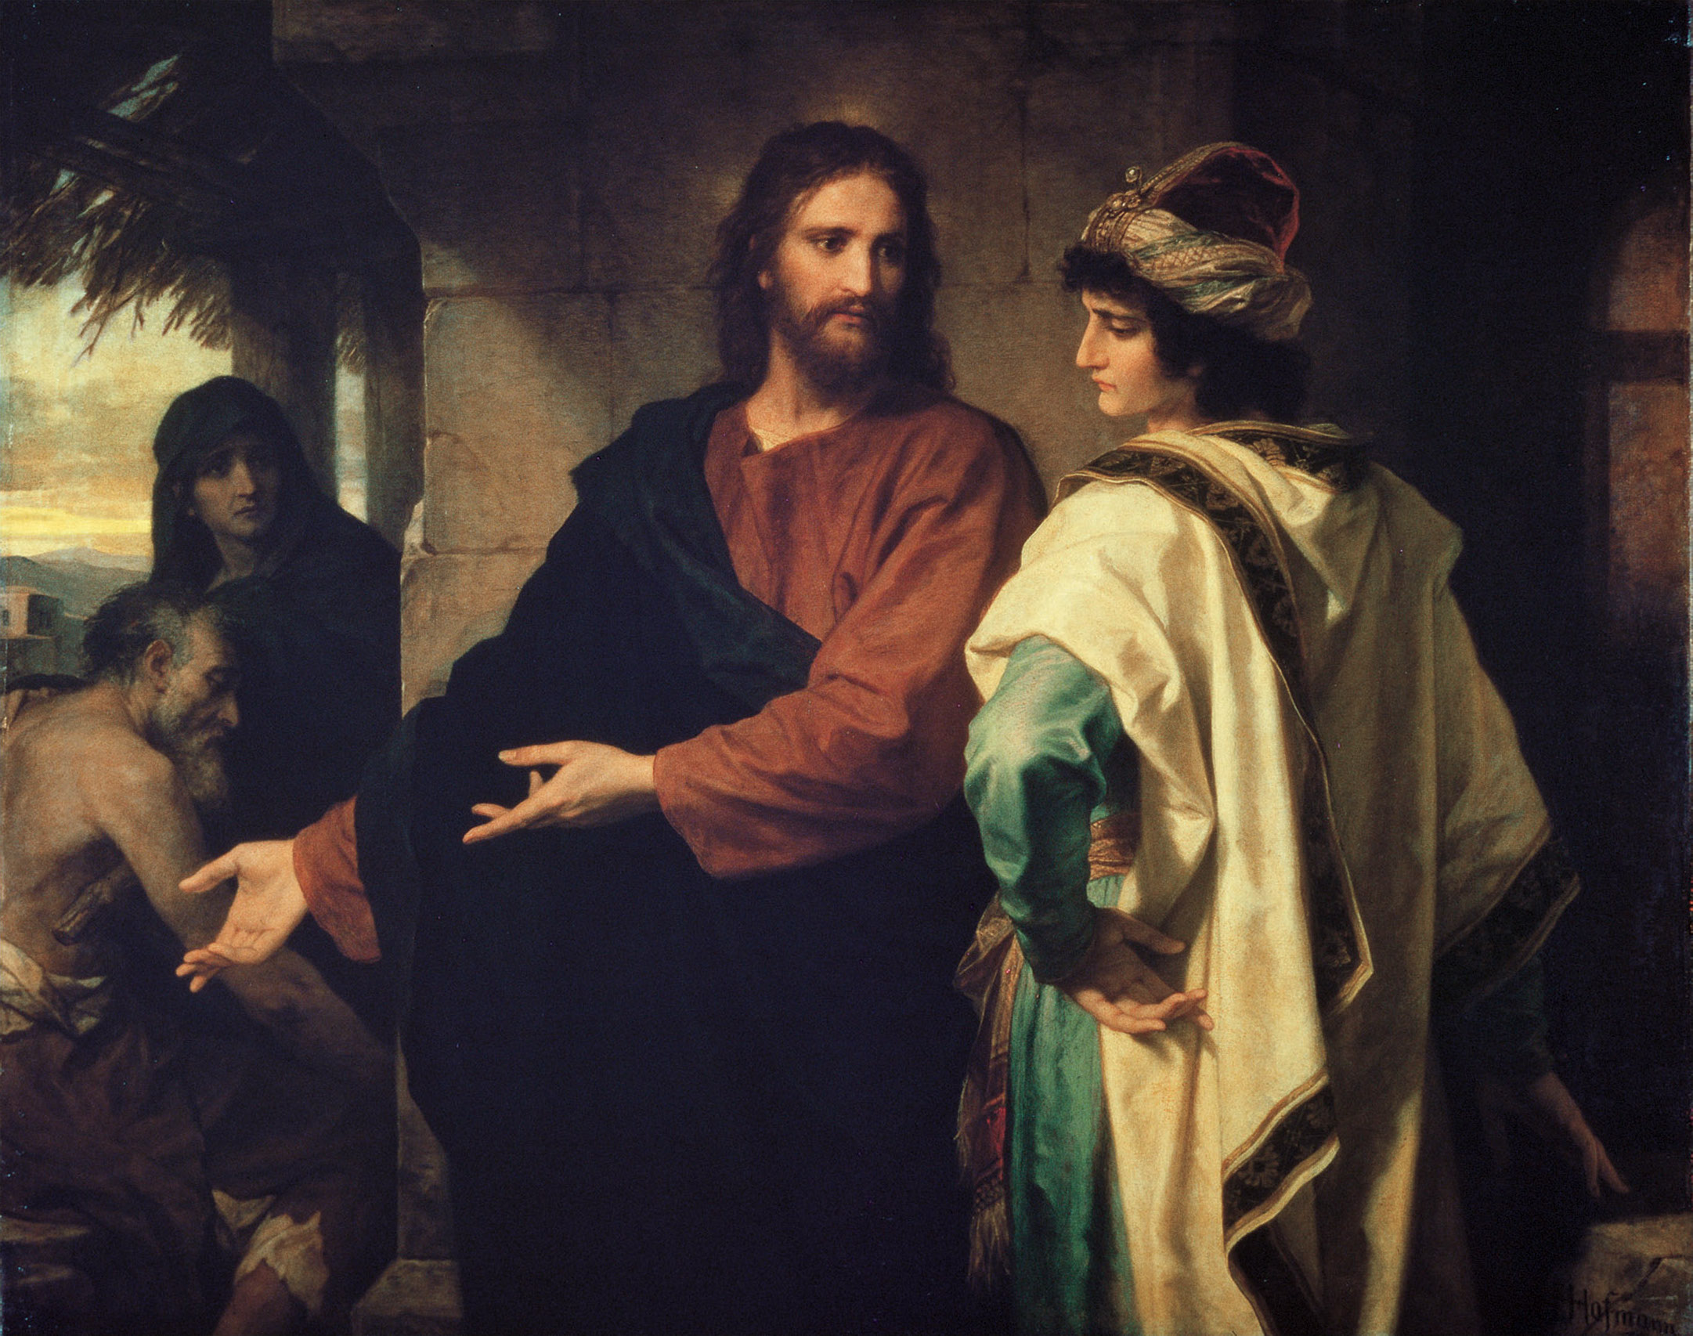
Notes:
"Follow me." But he said, "Lord, first let me go and bury my father.“ ⁶⁰ But Jesus said to him, "Let the dead bury their own dead; but as for you, go and proclaim the kingdom of God."
(Luk 9:59-60 NRS)
⁶² Jesus said to him, "No one who puts a hand to the plow and looks back is fit for the kingdom of God." (Luk 9:62 NRS)
We can not stay focused on our problems – doing all the talking – and not listen to God.
Worshipers listen – their tongues are bridled

Slide 22
  Christianity is not a religion that tries to control God’s blessings
  Christianity is a relationship that worships God.

Slide 23
If any think they are worshipers, and do not bridle their tongues but deceive their hearts, their worship is worthless. Worship that is pure and undefiled before God, the Father, is this: to care for orphans and widows in their distress, and to keep oneself unstained by the world.
Jam 1:9-12
Notes:
How does James define Pure and undefiled Worship?

Slide 24
Pure and Undefiled Worship Defined:
A Life of Serving Vulnerable People
A Life that is Unstained by the World
  The world stains us when we accept its ways as God’s ways.
  The world has stained us when we do not enter into the pain and problems of the world with God’s love.
Notes:
How are we stained by the world? When we accept the world’s culture as God’s way.
Example:
Brother’s sermon – and the man who came out of the choir to take the boy’s hat. Really!?!? That is what you take away from the story of the cross?
Facebook Page “Christians against Vegetarians” That is what you take away from the story of the cross?

Slide 25
  Assignment
  Close your eyes and ask God to show you were you are practicing the Christian Religion and where you are practicing Christian Worship.

