Slide 1


James in the Suburbs
A Disorderly Parable of the Epistle of James

Slide 2
LAST WEEK Review

Slide 3
James’s Strategy for Handling Problems
Accept Problems as a Servant’s Way of Life
Understand the Problem
See the Problem as Joy
Endure the Problem (but not idly)
Ask for Wisdom (without doubting that God will give wisdom)
Notes:
Everything James has taught in the Epistle so far has been with the purpose of helping his congregants handle their problems so that they could become effective servants of Christ.
James is going to have a few more things to say about Problems before next week’s lesson when he is going to start teaching us how to serve God.

Slide 4
Two Common Problems
Notes:
Two common Problems

Slide 5
Let the believer who is lowly boast in being raised up, and the rich in being brought low, because the rich will disappear like a flower in the field. For the sun rises with its scorching heat and withers the field; its flower falls, and its beauty perishes. It is the same way with the rich; in the midst of a busy life, they will wither away. Blessed is anyone who endures temptation. Such a one has stood the test and will receive the crown of life that the Lord has promised to those who love him.
-- Jam 1:9-12

Slide 6
Common Misunderstandings
These verses do not make a promise to the poor that God will give them more of whatever they lack
These verses do not warn the rich that God will make them poor.
Nor is James doing what he will do later in the letter which is to encourage the followers of Jesus to fight injustices against the poor.

Slide 7
Instead James names two problems. . .
Problem of having too little
Jesus: “And do not keep striving for what you are to eat and what you are to drink, and do not keep worrying. For it is the nations of the world that strive after all these things, and your Father knows that you need them. Instead, strive for his kingdom . . .” (Luk 12:29-31).
Problem of having too much
Jesus: “Sell your possessions, and give alms. Make purses for yourselves that do not wear out, an unfailing treasure in heaven, where no thief comes near and no moth destroys” (Luk 12:33).

Slide 8

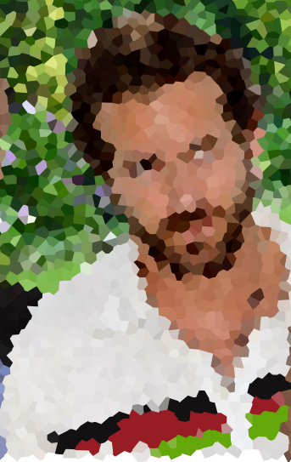
A Family in Rodney’s Village
Notes:
Tell both stories of having too little and having too much:
Stop at the end of “too little” to get comments on the story
Stop at the end of “too much” to get comments on the story

Slide 9
Goal of those with too little:
“Place all their dependence on God.”

Slide 10
Goal of those with too much:
“To put all that they have to good use in service to God and others.”
Notes:
Not to become poor.
How do we know how to do this? Ask for wisdom!
How is this different from what the world teaches? “the one with the most toys wins” “pay yourself first” “save for a rainy day”
This trial is before the wealthy every time they get a paycheck, dividend, etc. How have you experienced this trial?

Slide 11
The biggest trial most of us will ever face in the suburbs
is the trial of having too much.
“ . . . it is easier for a camel to go through the eye of a needle than for someone who is rich to enter the kingdom of God.“
-- Jesus (Luk 18:25)
Notes:
Tell the story of the wealthy ruler.

Slide 12
Let the believer who is lowly boast in being raised up, and the rich in being brought low, because the rich will disappear like a flower in the field. For the sun rises with its scorching heat and withers the field; its flower falls, and its beauty perishes. It is the same way with the rich; in the midst of a busy life, they will wither away. Blessed is anyone who endures temptation. Such a one has stood the test and will receive the crown of life that the Lord has promised to those who love him.
-- Jam 1:9-12
Notes:
Again Let’s look at the last verses of the section we are studying in James tonight . . . The section in red – re-read it.
Do you notice any similarities to what Jesus said on the sermon of the mount? “Blessed”
The good news for those with too much and those with too little . . . If we endure the trial, we will receive the crown of life.
But . . . . What is the difference between being successful and enduring?
Have you ever been faithful to God, but not successful in achieving a goal?

Slide 13
The Award for Endurance
Endurance is not having a successful outcome.
God doesn’t give awards based on success, but on endurance.
Endurance and obedience go hand in hand
Christ died accursed on the cross – not the picture of success – but certainly the picture of endurance and obedience.
“Humans rarely admire people
who have a track record that looks unsuccessful.
But God does.”

Slide 14
The Potential of Problems
Notes:
Talk about how this is a turning point in the book

Slide 15
No one, when tempted, should say, "I am being tempted by God"; for God cannot be tempted by evil and he himself tempts no one. But one is tempted by one's own desire, being lured and enticed by it; then, when that desire has conceived, it gives birth to sin, and that sin, when it is fully grown, gives birth to death. Do not be deceived, my beloved. Every generous act of giving, with every perfect gift, is from above, coming down from the Father of lights, with whom there is no variation or shadow due to change. In fulfillment of his own purpose he gave us birth by the word of truth, so that we would become a kind of first fruits of his creatures.
-- Jam 1:13-18

Slide 16
No one, when tempted, should say, "I am being tempted by God"; for God cannot be tempted by evil and he himself tempts no one. But one is tempted by one's own desire, being lured and enticed by it; then, when that desire has conceived, it gives birth to sin, and that sin, when it is fully grown, gives birth to death. Do not be deceived, my beloved. Every generous act of giving, with every perfect gift, is from above, coming down from the Father of lights, with whom there is no variation or shadow due to change. In fulfillment of his own purpose he gave us birth by the word of truth, so that we would become a kind of first fruits of his creatures.
-- Jam 1:13-18

Slide 17
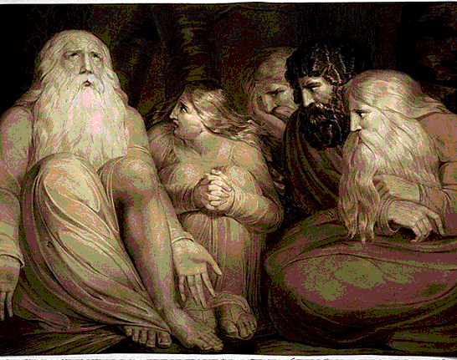
Story of Job
Did God tempt Job?
Notes:
Tell first part of story . . .
Technically James is right . . . God didn’t manufacture problems for Job. But God gave Satan permission. Does this bother anyone? Does it give anyone comfort?
Go on with story . . .
Would Job embrace his faith . . . the wisdom that God gave him – “I love you. And you haven’t caused this.”
Or would Job fall apart?
This is the nature of every trial . . .

Slide 18
Story of Job
The essence of every trial:
Will we worship God (serve God? Seek God’s wisdom?) or will we curse God and die?
Notes:
Job’s desire was to end his own suffering. His friends encouraged it.
But Job held onto the fact that God loved him . . . Instead of cursing God and dying . . . He worshipped God.

Slide 19
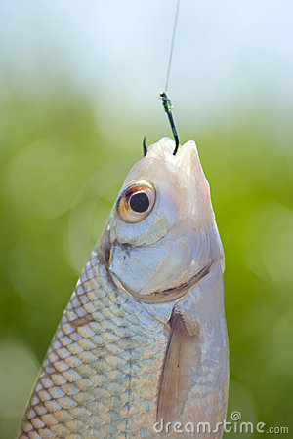
No one, when tempted, should say, "I am being tempted by God"; for God cannot be tempted by evil and he himself tempts no one. But one is tempted by one's own desire, being lured and enticed by it; then, when that desire has conceived, it gives birth to sin, and that sin, when it is fully grown, gives birth to death. Do not be deceived, my beloved. Every generous act of giving, with every perfect gift, is from above, coming down from the Father of lights, with whom there is no variation or shadow due to change. In fulfillment of his own purpose he gave us birth by the word of truth, so that we would become a kind of first fruits of his creatures.
-- Jam 1:13-18
Notes:
Job’s desire was to end his own suffering. His friends encouraged it.
But Job held onto the fact that God loved him . . . Instead of cursing God and dying . . . He worshipped God.

Slide 20
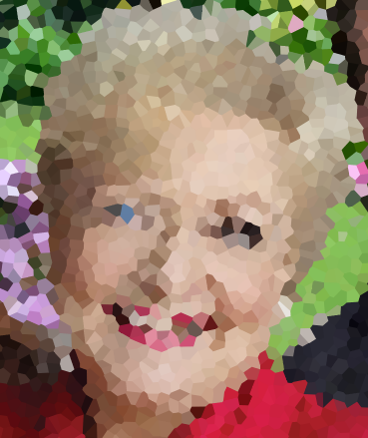
Liz’s Downward Spiral
Desires are not a bad thing in and of themselves. (The desire to be loved, to laugh, etc)
But desires do not always lead us where God’s wisdom will lead us.
Notes:
Have you every watched someone on a downward spiral? What desires are they pursuing?
Liz.. Running with the wrong men . . . The lesson she was learning was that all men were bad. She was pursuing the desire to be loved, but not in a way that was healthy or in a way that was waiting for God’s timing.
Like the fish hook, her healthy desire to be loved was entrapping her.
We see the opposite of following one’s desires, than in the Garden of Gethsemane

Slide 21
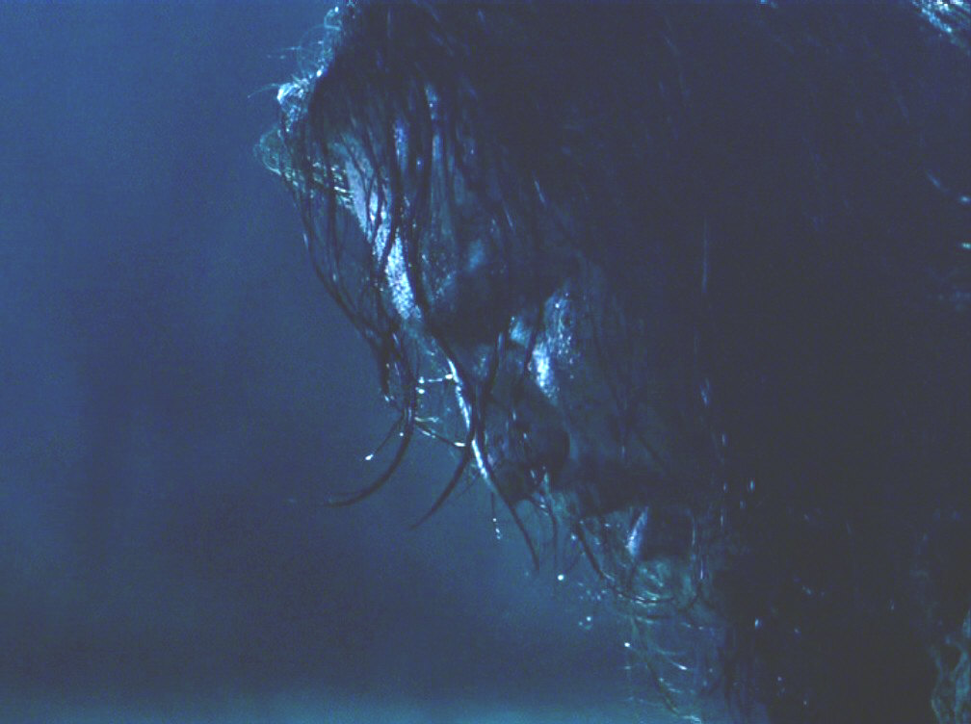
Jesus’s desire was for God to find another way.
God said no.
Jesus obeyed anyway.

Slide 22
“Often in the Suburbs, we raise our children to believe that God will grant all of their healthy desires. We don’t teach our children that God might not force the world to give them what is fairly theirs. They might not get enough of the love, food, or belongings they desire.
God may call them to live in want. They may have a choice to follow God with less or not follow God at all.
Following Christ is dangerous and hard.”
Notes:
Pause for discussion.

Slide 23
Turning Point
Notes:
Talk about how this is a turning point in the book

Slide 24
You must understand this, my beloved: let everyone be quick to listen, slow to speak, slow to anger; for your anger does not produce God's righteousness. Therefore rid yourselves of all sordidness and rank growth of wickedness, and welcome with meekness the implanted word that has the power to save your souls. But be doers of the word, and not merely hearers who deceive themselves. For if any are hearers of the word and not doers, they are like those who look at themselves in a mirror; for they look at themselves and, on going away, immediately forget what they were like. But those who look into the perfect law, the law of liberty, and persevere, being not hearers who forget but doers who act-- they will be blessed in their doing.
-- Jam 1:19-25

Slide 25
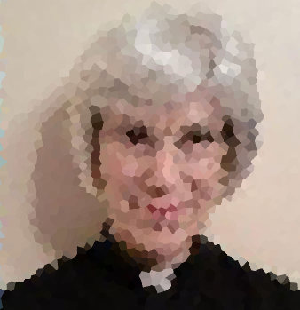
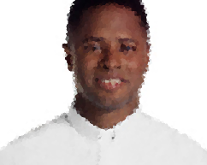
Two Priests: Choice to focus on our problems or serve God despite them.
Notes:
One priest: Stuck in addressing her problems. Never moving into servanthood.
Second priest: Real problems. Did not let his problems hold him back from being a servant.

Slide 26
You must understand this, my beloved: let everyone be quick to listen, slow to speak, slow to anger; for your anger does not produce God's righteousness. Therefore rid yourselves of all sordidness and rank growth of wickedness, and welcome with meekness the implanted word that has the power to save your souls. But be doers of the word, and not merely hearers who deceive themselves. For if any are hearers of the word and not doers, they are like those who look at themselves in a mirror; for they look at themselves and, on going away, immediately forget what they were like. But those who look into the perfect law, the law of liberty, and persevere, being not hearers who forget but doers who act-- they will be blessed in their doing.
-- Jam 1:19-25
Notes:
James wants their attention! Listen up!

Slide 27
You must understand this, my beloved: let everyone be quick to listen, slow to speak, slow to anger; for your anger does not produce God's righteousness. Therefore rid yourselves of all sordidness and rank growth of wickedness, and welcome with meekness the implanted word that has the power to save your souls. But be doers of the word, and not merely hearers who deceive themselves. For if any are hearers of the word and not doers, they are like those who look at themselves in a mirror; for they look at themselves and, on going away, immediately forget what they were like. But those who look into the perfect law, the law of liberty, and persevere, being not hearers who forget but doers who act-- they will be blessed in their doing.
-- Jam 1:19-25
Notes:
Earwax

Slide 28
You must understand this, my beloved: let everyone be quick to listen, slow to speak, slow to anger; for your anger does not produce God's righteousness. Therefore rid yourselves of all sordidness and rank growth of wickedness, and welcome with meekness the implanted word that has the power to save your souls. But be doers of the word, and not merely hearers who deceive themselves. For if any are hearers of the word and not doers, they are like those who look at themselves in a mirror; for they look at themselves and, on going away, immediately forget what they were like. But those who look into the perfect law, the law of liberty, and persevere, being not hearers who forget but doers who act-- they will be blessed in their doing.
-- Jam 1:19-25
Notes:
This is the key!

Slide 29
Welcome with meekness the implanted word that has the power to save your souls.
Notes:
This is the key! What is the implanted word of God?

Slide 30
The Implanted Word
It is not Scripture or Memorized Scripture
It is the Holy Spirit – the word of God implanted within us.
We are to welcome the Holy Spirit with meekness
The Spirit isn’t inside us because we deserve it
  We do not control the Spirit.
  We welcome it. Desire it.
  It gives us wisdom to serve God and others
Notes:
Word of God
Jesus was the word until he sent the Holy Spirit to be the word for us today
Holy Spirit lives in all those who follow Christ.

Slide 31
You must understand this, my beloved: let everyone be quick to listen, slow to speak, slow to anger; for your anger does not produce God's righteousness. Therefore rid yourselves of all sordidness and rank growth of wickedness, and welcome with meekness the implanted word that has the power to save your souls. But be doers of the word, and not merely hearers who deceive themselves. For if any are hearers of the word and not doers, they are like those who look at themselves in a mirror; for they look at themselves and, on going away, immediately forget what they were like. But those who look into the perfect law, the law of liberty, and persevere, being not hearers who forget but doers who act-- they will be blessed in their doing.
-- Jam 1:19-25

Slide 32
Two Kinds of People
Doers of the Word
Hearers of the Word
They act on the implanted word’s guidance.
They don’t necessarily do a lot, but they do what God wants them to do.
The do intentional good works that God created for them to do before they were even born.
They know exactly what God is telling them to do, but they fail to do it.
Their faith is verbalized and well intentioned, but there is nothing to show for it.
They may do random acts of kindness, but not the works God has planned for them to do

Slide 33
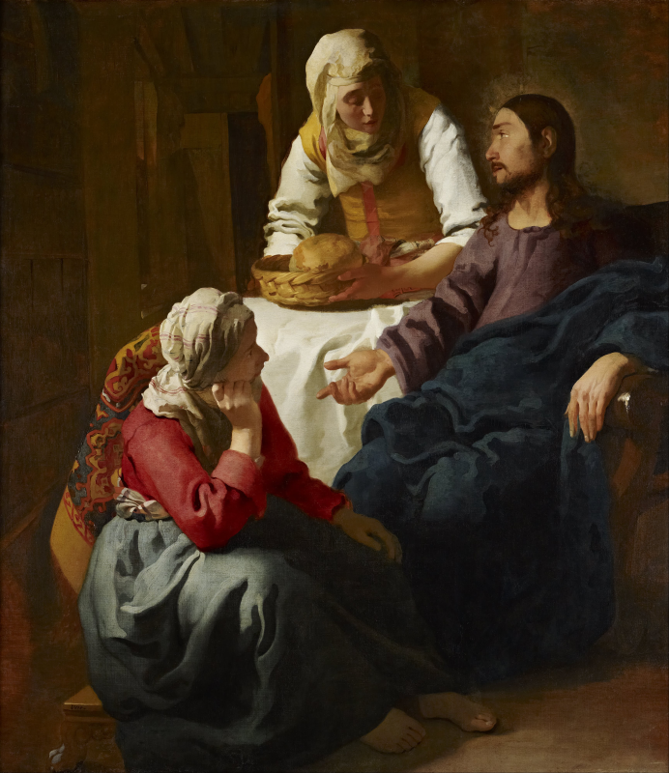
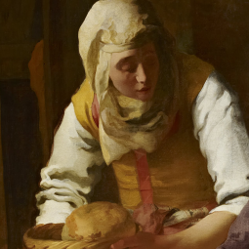
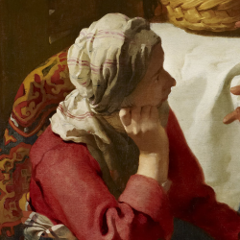
Two Kinds of People
Martha: Doer, but not of the Word
Mary: Hearer of the word. Doer later?

Slide 34
The Turning Point is this . . .
“ Will we be doers of the word or hearers only?”

Slide 35
Reflect upon whether you are
A hearer and a doer?
A hearer only?
A doer only?

