Slide 1


James in the Suburbs
A Disorderly Parable of the Epistle of James

Slide 2
LAST WEEK Review
James’s Strategy for Dealing with Problems

Slide 3
James’s Strategy for Handling Problems
Accept Problems as a Servant’s Way of Life
Understand the Problem
See the Problem as Joy
Endure the Problem (but not idly)
Ask for Wisdom (This week)
Notes:
Asking for Wisdom is key! The first four things get in you in the right frame of mind. But asking for wisdom is key to everything.

Slide 4
Wisdom and Doubting
Chapter 11 and 12

Slide 5
If any of you is lacking in wisdom, ask God, who gives to all generously and ungrudgingly, and it will be given you.
--Jam 1:5
Notes:
James make us this promise . . .

Slide 6
How often do you lack wisdom in dealing
with the situations that you find yourself in?
Notes:
Tell about young marrieds retreat at Peachtree . . . This was their #1 problem . . . Knowing God’s will for their family.
Tell about conversation with Roger Nishioka . . . Teens aren’t being taught how to seek God’s will . . . They need to know this by the 11 or 12 grade . . . Big decisions coming up
Suitable for all ages . . . Big decisions about retirement, finances, etc

Slide 7
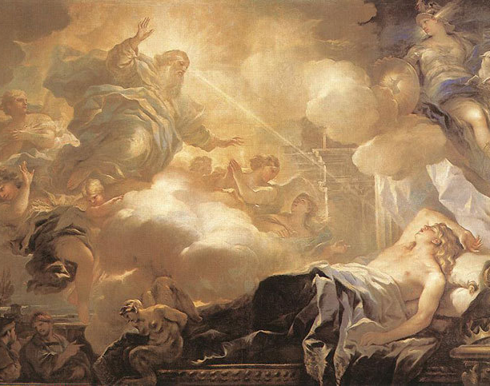
Solomon asks for Wisdom
James teaches that followers of Christ get wisdom the same way Solomon got wisdom: They ask!
Notes:
Asking God for wisdom is not a new idea . . . Tell the story of King Solomon --- Ten centuries prior to James . . . King Solomon gathers his most trusted advisors and heads to the top of a mountain where he holds a party where they spend the evening worshiping and praising God. When nighttime came, Solomon went to sleep. In the dream, God asks Solomon, “What do you need from me?” And Solomon answers, “Give me wisdom so that I can lead your people.” God was impressed with Solomon’s unselfish request . . . And granted it. Solomon became known as the wisest man who ever lived.

Slide 8
If any of you is lacking in wisdom, ask God, who gives to all generously and ungrudgingly, and it will be given you.
--Jam 1:5
Notes:
In fact . . . When we ask . . . God has promised not to hold back! We don’t have to earn God’s wisdom!

Slide 9
Reasons we ask for wisdom and don’t get it
We don’t take time to listen for the answer
We don’t recognize wisdom when it is given to us
We doubt God has given us wisdom

Slide 10
Reasons we ask for wisdom and don’t get it
We don’t take time to listen for the answer
We don’t recognize wisdom when it is given to us
We doubt God has given us wisdom

Slide 11
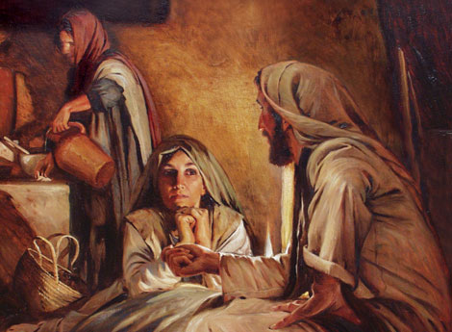
Martha and Mary
If we act without listening we miss what is important and necessary.
Notes:
Martha was busy working without having listened to Jesus.
Mary listened.
Martha was doing what she thought had to be done. But she had she forgotten that Jesus had fed 5000? Certain he could have whipped up dinner that night.

Slide 12
Reasons we ask for wisdom and don’t get it
We don’t take time to listen for the answer
We don’t recognize wisdom when it is given to us
We doubt God has given us wisdom
Notes:
So what is wisdom? Start by talking about what wisdom is not . . .

Slide 13

Hosea and his unfaithful Wife
Wisdom is not doing what makes common sense.
Notes:
Tell Story of Hosea

Slide 14
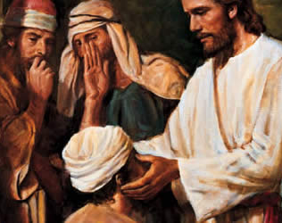
Jesus Heals on the Sabbath
Wisdom is not following a list of rules.

Slide 15
Wisdom is not a concept. It is the Living Spirit of God.
Notes:
Some stories that demonstrate that Wisdom is the living Spirit of God.

Slide 16
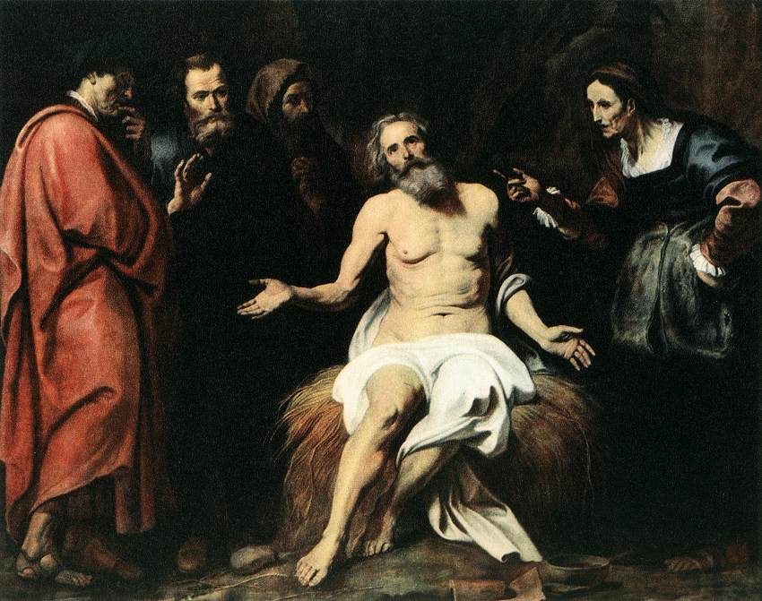
Job
Job said that it is “the breath of the Almighty that makes for understanding.” Job knew the spirit of God had been breathed into him.
Wisdom may not make us popular, successful, wealthy, or problem free.
Notes:
Tell Story of Job . . . Then summarize

Slide 17
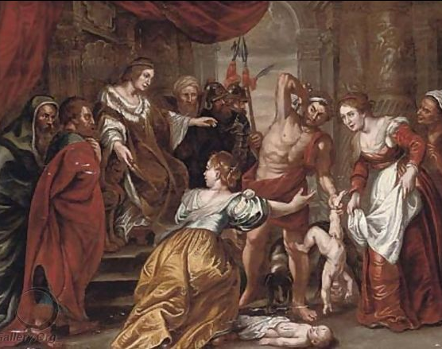
King Solomon
“The wisdom of God was in him.” – Nation of Israel
“The Spirit of Wisdom came to me.” – King Solomon
Notes:
Tell Story of King Solomon and two Prostitutes

Slide 18
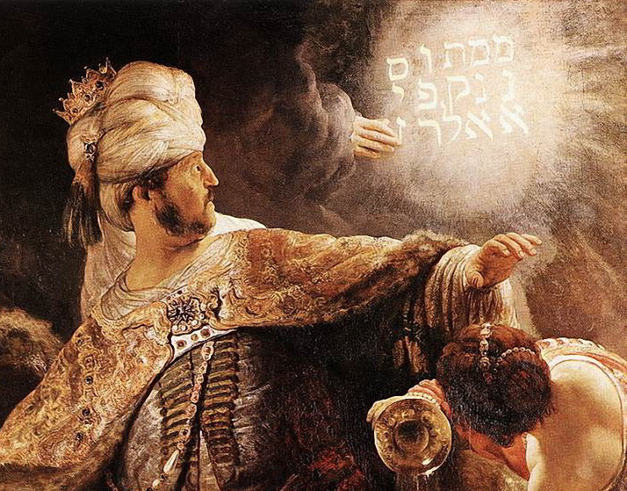
Disembodied Hand
Daniel is “endowed with the sprit of the holy gods” – Advisors to the King of Babylon
Notes:
Tell Story of Daniel . . .

Slide 19
The Holy Spirit, the eternal and perfect source of wisdom, indwells believers and reveals to them everything they need to know to serve God and others.
Notes:
BUT we must be open to it . . .

Slide 20
Reasons we ask for wisdom and don’t get it
We don’t take time to listen for the answer
We don’t recognize wisdom when it is given to us
We doubt God has given us wisdom

Slide 21
But ask in faith, never doubting, for the one who doubts is like a wave of the sea, driven and tossed by the wind; for the doubter, being double-minded and unstable in every way, must not expect to receive anything from the Lord.
--Jam 1:5-7

Slide 22
But ask in faith, never doubting, for the one who doubts is like a wave of the sea, driven and tossed by the wind; for the doubter, being double-minded and unstable in every way, must not expect to receive anything from the Lord.
--Jam 1:5-7

Slide 23
Which is James’s definition of faith?
The belief that God will do whatever we ask.
Action that follows the Holy Spirit’s wisdom.

Slide 24


“Asking in Faith”
Notes:
Olivia and Doug – Doug believed hard enough and didn’t get it.

Slide 25
If any of you is lacking in wisdom, ask God, who gives to all generously and ungrudgingly, and it will be given you. But ask in faith, never doubting, for the one who doubts is like a wave of the sea, driven and tossed by the wind; for the doubter, being double-minded and unstable in every way, must not expect to receive anything from the Lord.
--Jam 1:5-7

Slide 26

Sailing in the Caribbean
Notes:
The person who seeks wisdom, but isn’t sure that God will give it to them (or has given it to them), is unstable in all their ways. When waves are pleasant they think they have followed God’s wisdom. When things are difficult, they doubt.

Slide 27

Rodney’s Medical Equipment
Notes:
There is no way to “follow” Jesus by the “catch up to me and stop me” method.

Slide 28
Reasons we ask for wisdom and don’t get it
We don’t take time to listen for the answer
We don’t recognize wisdom when it is given to us
We doubt God will or has given us wisdom

