Slide 1


James in the Suburbs
A Disorderly Parable of the Epistle of James

Slide 2
Intro to the Epistle (Chapters 5-7)

Slide 3
Vital Details of the Epistle
What kind of document is the Epistle of James?
Who was it written to?
How are the recipients different from us?
How are they similar?
Why is it important to know the origins of scripture?
Notes:
Epistle = letter with the intention of teaching the readers
Written to a group of 1st C Christians – we don’t know who exactly who they were. We do know that at that time, the church:
Was under persecution
Suffering poverty (no one wanted to hire you)
Different: We don’t know persecution or poverty or discrimination to the degree that they did. They didn’t have a church building, a church golf cart or utility payments to worry about. Life was about survival. Their problems were more real than ours?
Alike: Loved Jesus, believe he had been resurrected from the death.
Important: tell about publisher and disagreement over tense. Give example of “Paul says women will not speak in church” and how that is different from “Paul said women were not to speak in church.”

Slide 4
Mystery

Slide 5
Mystery: Who wrote the letter?
James, disciple and the son of Zebedee and brother of John (also a disciple)
James, disciple and the son of Alphaeus.
James, the father of the disciple Judas (not Judas Iscariot)
James, brother of Jesus

Slide 6
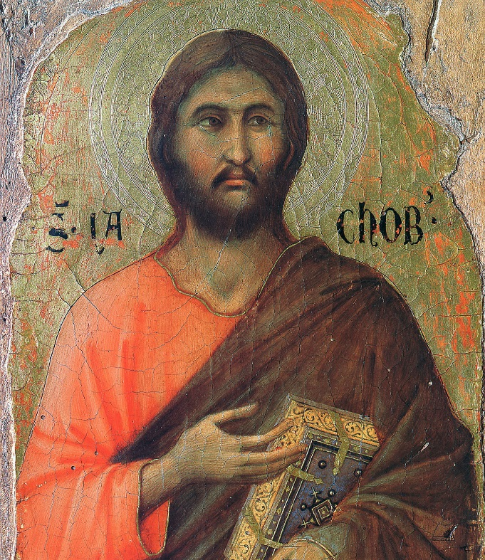

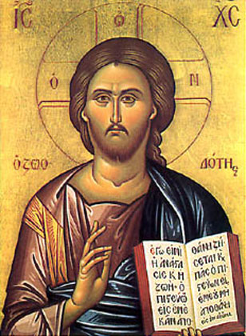
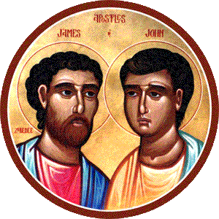
Will the Real James Standup?
Notes:
I am going to tell you what I know about the four James’s and then we will vote on which one wrote the scripture . . .
So pay attention and consider which James you think might have written the Epistle . . .

Slide 7
Disciple, son of Zebedee and brother of John (also a disciple)
A disciple and fisherman - Matt 4:21
His mom asked for special seats - Mark 10:35
Witness to the transfiguration - Matt 17:1
He wanted to smite a whole town when they turned Jesus away. Jesus rebuked him – Luke 9:54
Jesus took him to garden of Gethsemane where he fell asleep instead of praying for Jesus - Mark 14:33
His mother was at the cross with Mary - Matt 27:56
Martyred by King Herod - Acts 12:2
Notes:
Extra points for anyone who knows what nickname these two brothers had?
Downside: He was martyred right after Jesus – so there wasn’t a lot of time for him to write this letter.

Slide 8

James, disciple and the son of Alphaeus.
A disciple - Matt 10:3
His mother was also at the cross with Mary - Matt 27:56
His mother was one of women to first see the
resurrected Jesus and tell the disciples - Luke 24:10
Notes:
Downside: Nothing special that would single him out.

Slide 9
The father of the disciple Judas (not Judas Iscariot)
We know nothing about him.
Notes:
Downside: Unlikely that the author of James would
never be mentioned anywhere else in
scripture

Slide 10
Brother of Jesus
He was notable as leader of the church
in Jerusalem. This meant he could go by his
first name alone and be recognized.
In Acts 15 we have a sermon of his. Some
scholars think the language is similar to the
Epistle. To be honest, I don’t see it.
The Epistle has sophisticate Greek vocabulary
and grammar.
Notes:
Down Side: Not the writing of a peasant

Slide 11
Vote!
Notes:
James, disciple and the son of Zebedee and brother of John (also a disciple) ← Martyred
James, disciple and the son of Alphaeus. ← Nothing Special about him
James, the father of the disciple Judas (not Judas Iscariot) ← Completely unknown
James, brother of Jesus ← Vocabulary too sophisticated

Slide 12
Controversy

Slide 13
Controversy: This letter has been so disliked!
Luther: “James Mangles the Scriptures” and “therefore I will not have him in my Bible to be numbered among the true chief of books.” He went on to call James an “Epistle of Straw.”
Calvin: James was “sparing in proclaiming the grace of Christ” and judged the epistle “not behooving of an apostle.”
Verbalized Problem: James doesn’t teach what Jesus teaches!
Notes:
I believe there was more to this than what we have heard in the past - simply because the Epistle of James is so close to the Sermon on the Mount . . .

Slide 14
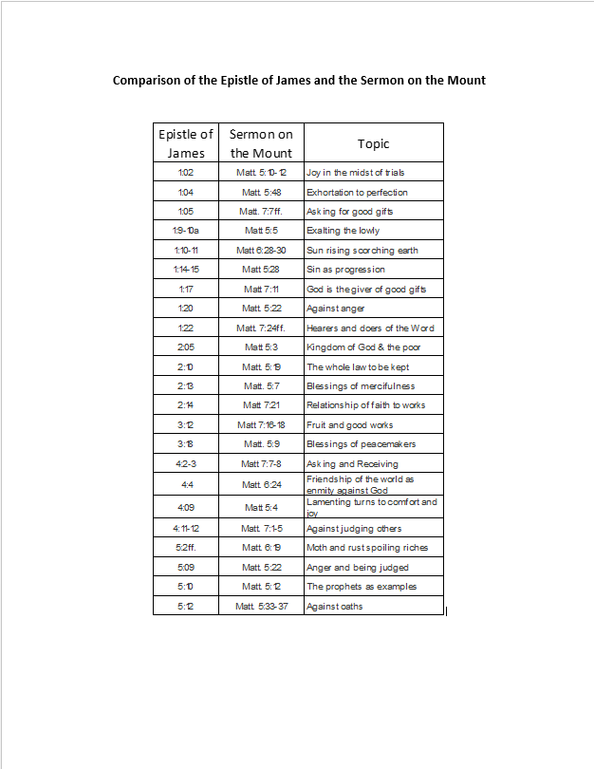
Comparison of James and the Sermon on the Mount
Notes:
This handout is available on the website.

Slide 15
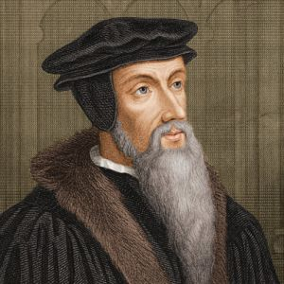
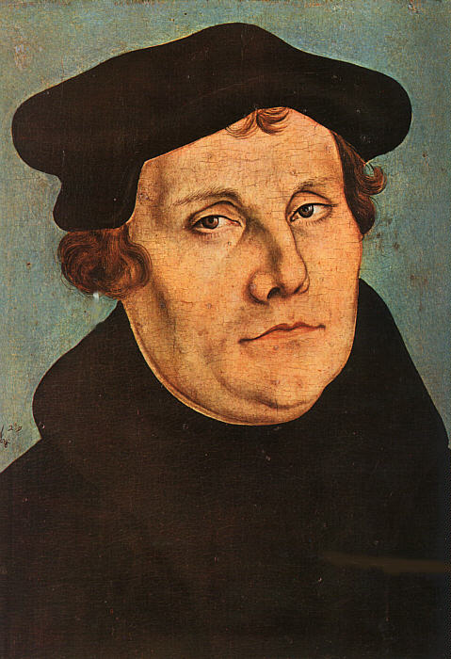
Despite James’s closeness to the Sermon on the Mount, there was controversy. Why?
Notes:
I think it is still the same reason the book causes controversy today.
It is offensive to the way we live. It points out how badly we are off the mark. I believe it pointed out how badly Calvin and Luther were off the mark too.

Slide 16
James’s message is offensive:
The Christian life is not about acquiring God’s blessings, not about having the right theology, not about following the right set of rules.
It is about serving God and others!

Slide 17
James, a servant of God and of the Lord Jesus Christ
-- Jam 1:1

Slide 18
James, a servant of God and of the Lord Jesus Christ
-- Jam 1:1

Slide 19
James, a slave of God and of the Lord Jesus Christ
-- Jam 1:1
δοῦλος is better translated as “slave”

Slide 20
Concept of Slavery to God
Started in the Old Testament
  Leaders: David and Moses
  Prophets: Jeremiah and Amos
  Psalms: Jewish People
New Testament
  “Paul, a servant of Jesus Christ” (Rom 1:1)
  “Paul, a servant of God” (Tit 1:1)
  “James, a servant of God and of the Lord Jesus Christ” (Jam 1:1)
  “Simeon Peter, a servant and apostle of Jesus Christ” (2Pe 1:1)
  “The revelation . . . to his servants... through his servant John” (Rev 1:1)

Slide 21
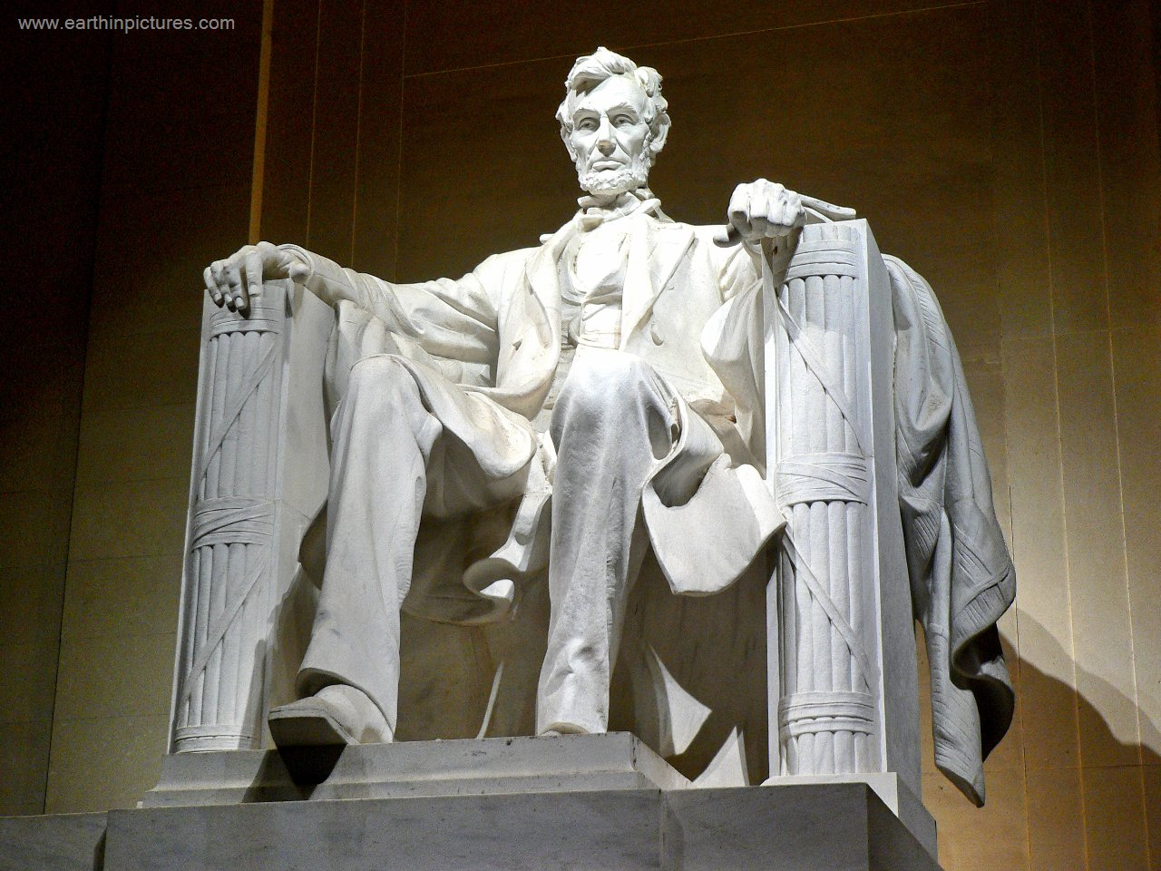
But Slavery is Offensive!
Notes:
Tell Story of Abraham Lincoln

Slide 22
The BIG Catch
Slavery to God requires
that we also serve each other
“Whoever wishes to be great among you must be your servant”
(Mar 10:43)
Notes:
Ask if they can think of incidents where Jesus emphasized this . . .
Washing of Feet at the Last Supper
Son’s of Zebedee asking for the best seat

Slide 23
To the twelve tribes in the Dispersion: Greetings!
-- Jam 1:1

Slide 24
To the twelve tribes in the Dispersion: Greetings.
-- Jam 1:1
διασπορᾷ literally means “scattering.”

Slide 25
Diaspora
First One:
  God’s Old Testament plan for the Kingdom of God:
  Experience God’s blessings while externally blessing and welcoming outsiders
  The Kingdom Fails
  Scattering of Jews by conquering nations
Second One:
  1st C scattering of Christians because of persecution
Notes:
God’s Plan: God’s slaves would live in twelve tribes that would invite the world in to be part of this abundant Kingdom of God.
Failure to live as God required

Slide 26
Kingdom of God
The goal of the OT Kingdom of God and the NT Kingdom of God was/is basically the same goal:
The people of God are to experience
God’s abundant blessings as a community
while inviting outsiders into
join them in God’s Kingdom.

Slide 27
Discussion Questions:
Are you comfortable being called the slave of God?
Are you comfortable being the servant of others? Even your enemies?
How do you practice being a slave to God and others?
Notes:
Ask them to find a person you don’t know to discuss this with . . .

Slide 28
Closing Prayer

